Slide 1
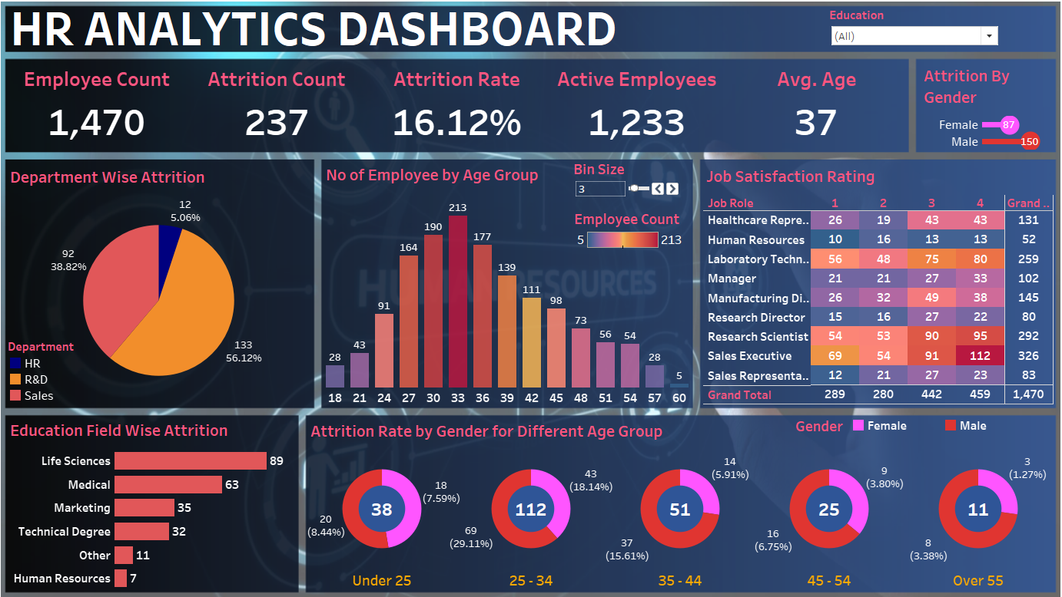
Dashboard Overview

Slide 2
Objective
To analyze employee attrition trends and identify key influencing factors.
To provide insights into department-wise, education-wise, and age-wise attrition rates.
To evaluate job satisfaction levels and their impact on attrition.
To help HR teams make data-driven decisions for employee retention strategies.
To enhance workforce planning through interactive visualizations and KPIs.

Slide 3
Project Overview
This HR Analytics Dashboard provides insights into Employee attrition, Department-wise trends, Education-based attrition, Job satisfaction ratings, and more. It helps HR teams make data-driven decisions to improve Employee retention.

Slide 4
Data Description
The dataset includes employee details such as department, education field, age group, job satisfaction rating, gender-wise attrition, and total employee count.

Slide 5
Target Audience
This dashboard is designed for HR professionals, business managers, and decision-makers who aim to reduce attrition rates and improve workforce planning.

Slide 6
Key Features
Employee count, attrition rate, and active employees
Department and education-wise attrition analysis
Age group-wise attrition trends
Job satisfaction ratings across roles
Gender-wise attrition breakdown

Slide 7
Tools and Techniques
Filters & Slicers – Education, Gender-based attrition
Charts & Visuals – Pie, Bar, Heatmap
Conditional Formatting – Color-coded job satisfaction levels
Aggregation & Grouping – Age, Department, Education-wise attrition
KPIs & Metrics – Employee count, Attrition rate, Active employees
Interactivity – Drill-down, dynamic data exploration

Slide 8
Scope and Limitations
Scope:
• Provides attrition insights and key HR metrics
• Helps in workforce planning
• Assists in improving employee retention strategies
Limitations:
• Limited to historical data
• Does not include predictive analytics for attrition

Slide 9
Outcomes
Identify high-attrition departments and education fields
Understand gender and age group-wise attrition trends
Improve job satisfaction strategies
Enhance employee retention through data-driven decisions

Slide 10
Conclusion
This HR Analytics Dashboard offers a comprehensive view of employee attrition patterns, helping organizations optimize workforce strategies and reduce turnover.

Slide 11
Thank You For Your Attention!

